Slide 1
biomass

Slide 2
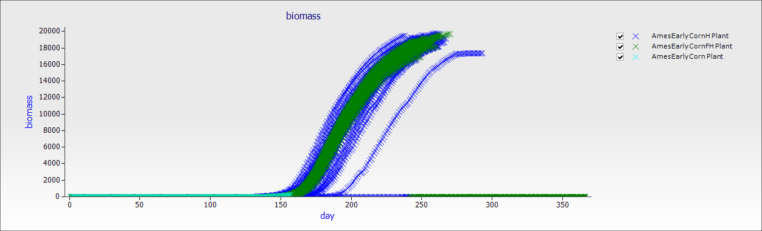
2015 management with historical weather years
May 25 forecast
2015 management with actual weather data up to today, plus 14 d forecast plus historical weather years thereafter
We will add measured data points here are well
2015 management with actual weather data up to today plus 14 d forecast

Slide 3
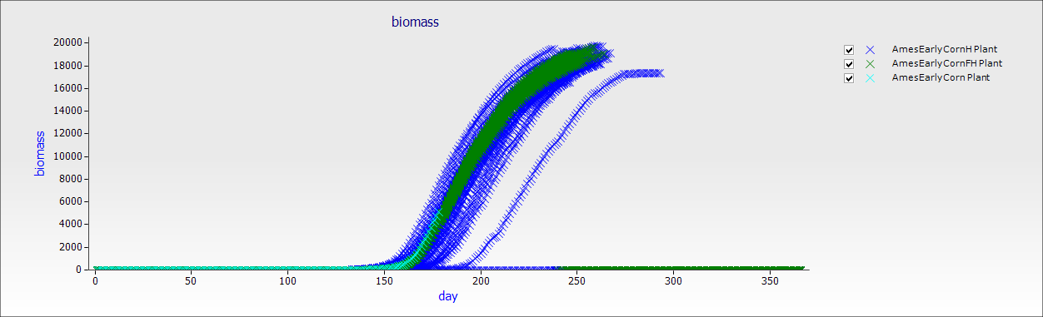
June 26 forecast

Slide 4
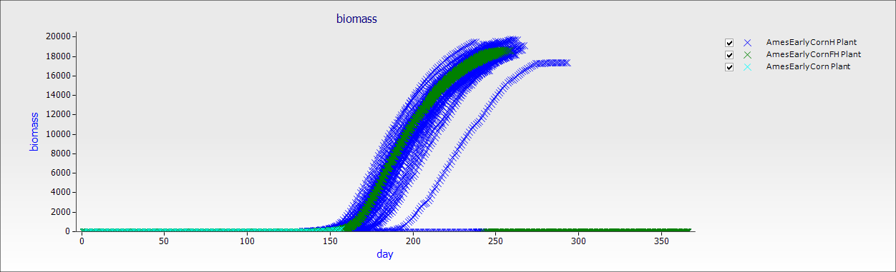
July 27 forecast

Slide 5

August 21 forecast

Slide 6
lai

Slide 7
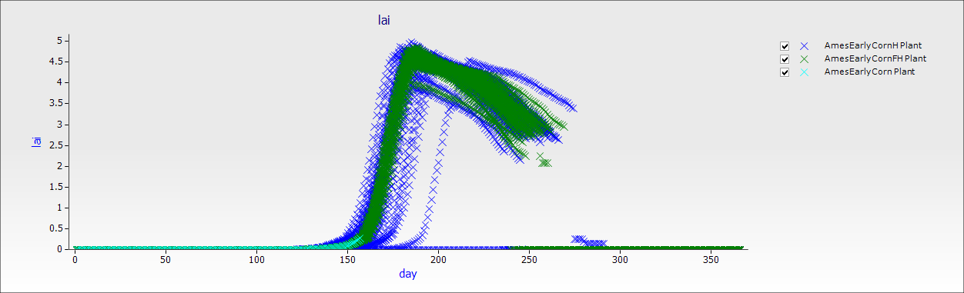
May 25 forecast

Slide 8
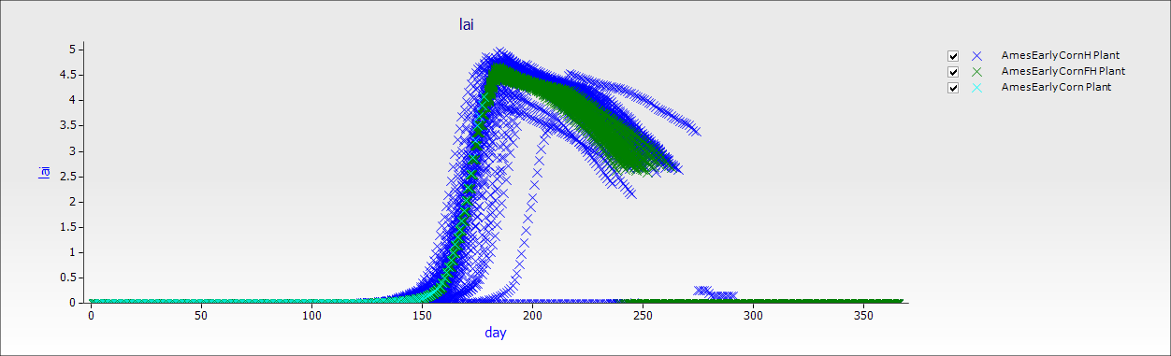
June 26 forecast

Slide 9

July 27 forecast

Slide 10

August 21 forecast

Slide 11
Corn Yield

Slide 12
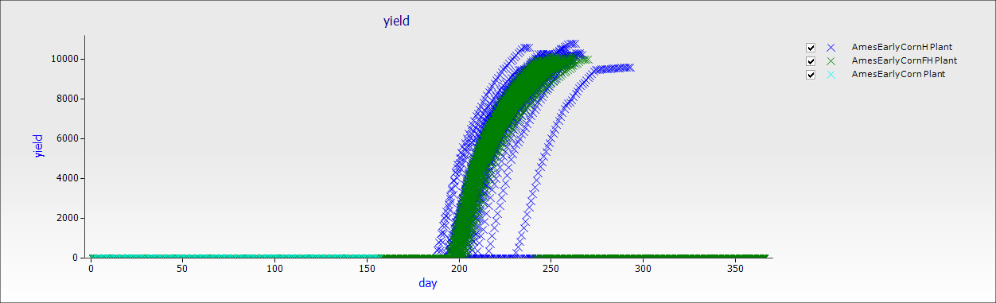
May 25 forecast

Slide 13
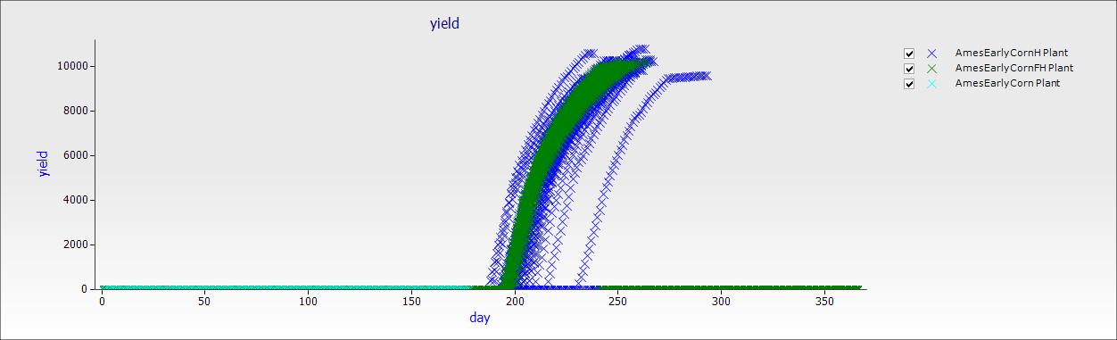
June 26 forecast

Slide 14

July 27 forecast

Slide 15
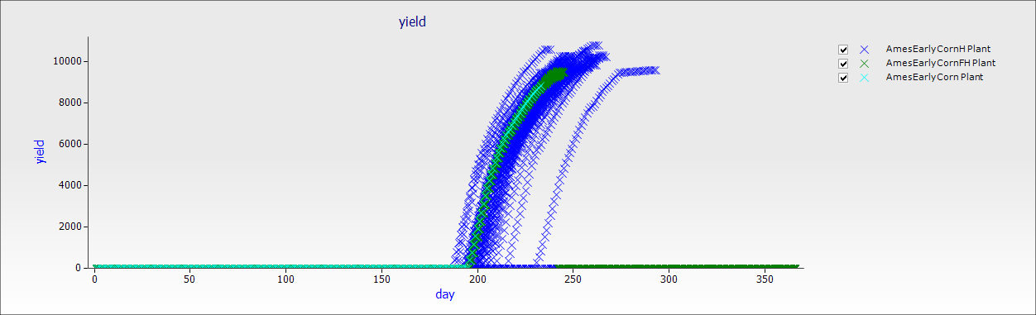
August 21 forecast

